Slide 1
Final Project Enterprise Analytics Data Sectuals
Noah Mukhtar
Ramy Hammam
Jerry Jahangir
Shaan Kohli
Venkatesh Chandra

Slide 2
Agenda
Context & Hypothesis
Data Exploration
Model & Results
Explainability of Results
Threats to Validity
Conclusions
Improvements to Model

Slide 3
1. Context & Hypothesis

Slide 4
1.a Context
OBJECTIVE A: EXPLORATIVE & CUSTOMER PROFILING
Exploit data to better understand customers
Discover new customer segments
Aid profiling of potential customers
Identify ideal potential customers

Slide 5
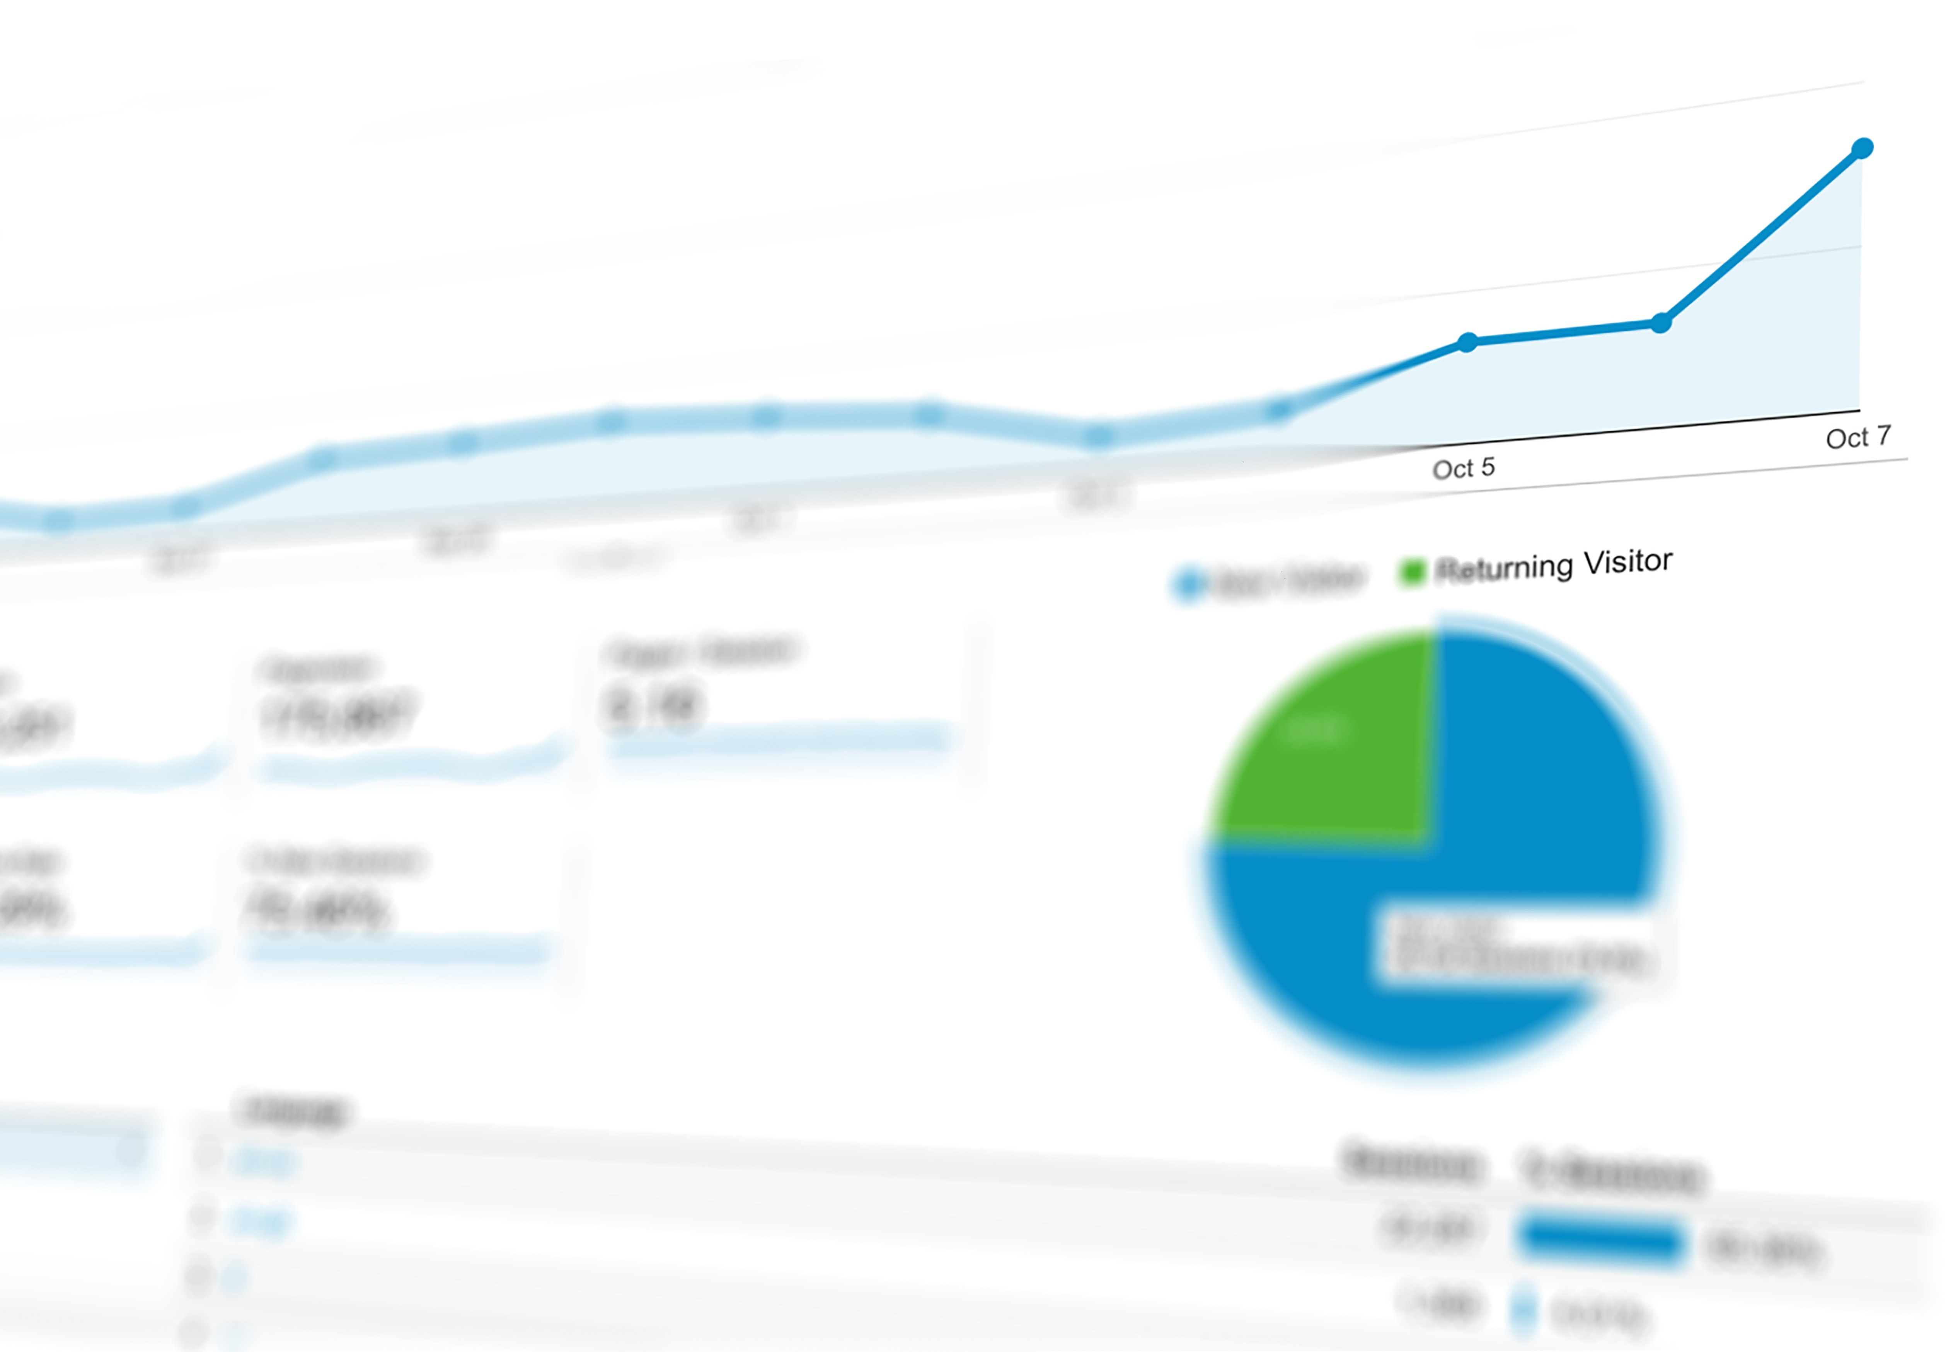
1.a Context
OBJECTIVE B: PREDICTIVE MODELLING OF NEW MARKETING CAMPAIGN
Use insights from OBJECTIVE A to develop a new marketing campaign
Per customer segment
Clarification of factors that impact campaign’s results
Optimize allocation of resources
Labor
Credit terms
Diversification of portfolio

Slide 6
1.b Dataset & Hypothesis
Ho : Marketing campaign has no effect on deposit
Ha : Marketing campaign has some effect on deposit
Target variable – Term Deposit
Predictors – Age, Job, Marital, Education, Default, Housing Loan taken, Loan, Balance in Account, etc.
Controllable variables – Duration, pday, previous contacts
Type 1 error - The customer did not deposit money, but our model predicted the opposite
Type 2 error - The customer deposited money but our model captured no deposit

Slide 7
2. Data Exploration

Slide 8
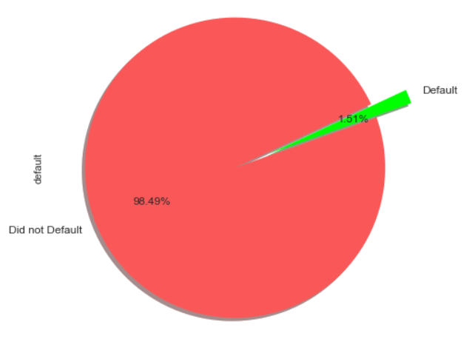
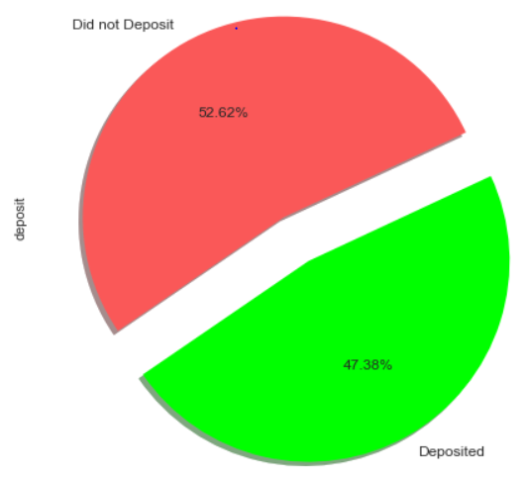
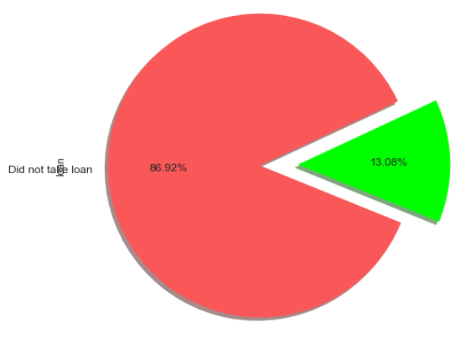
2. Data Exploration
Check Datatypes | Summary Statistics | Pandas Profiling
1.5% data points defaulted
Distribution of deposit
Distribution of loan

Slide 9
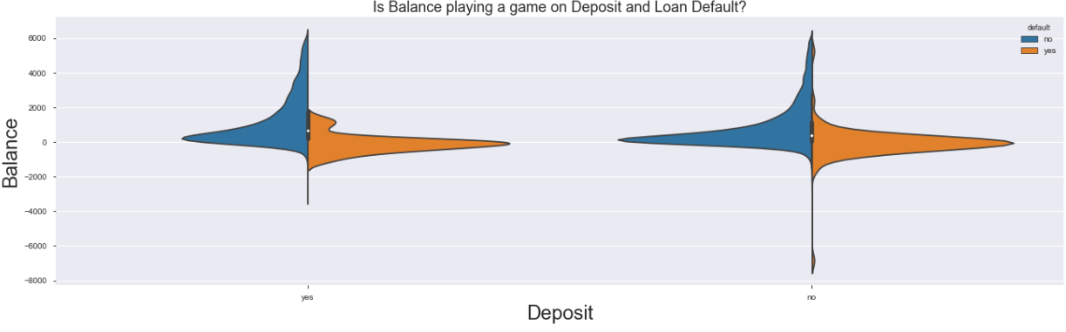
2.1 Insights from EDA
Those who default have low balance in their account

Slide 10
3. Model & Results

Slide 11
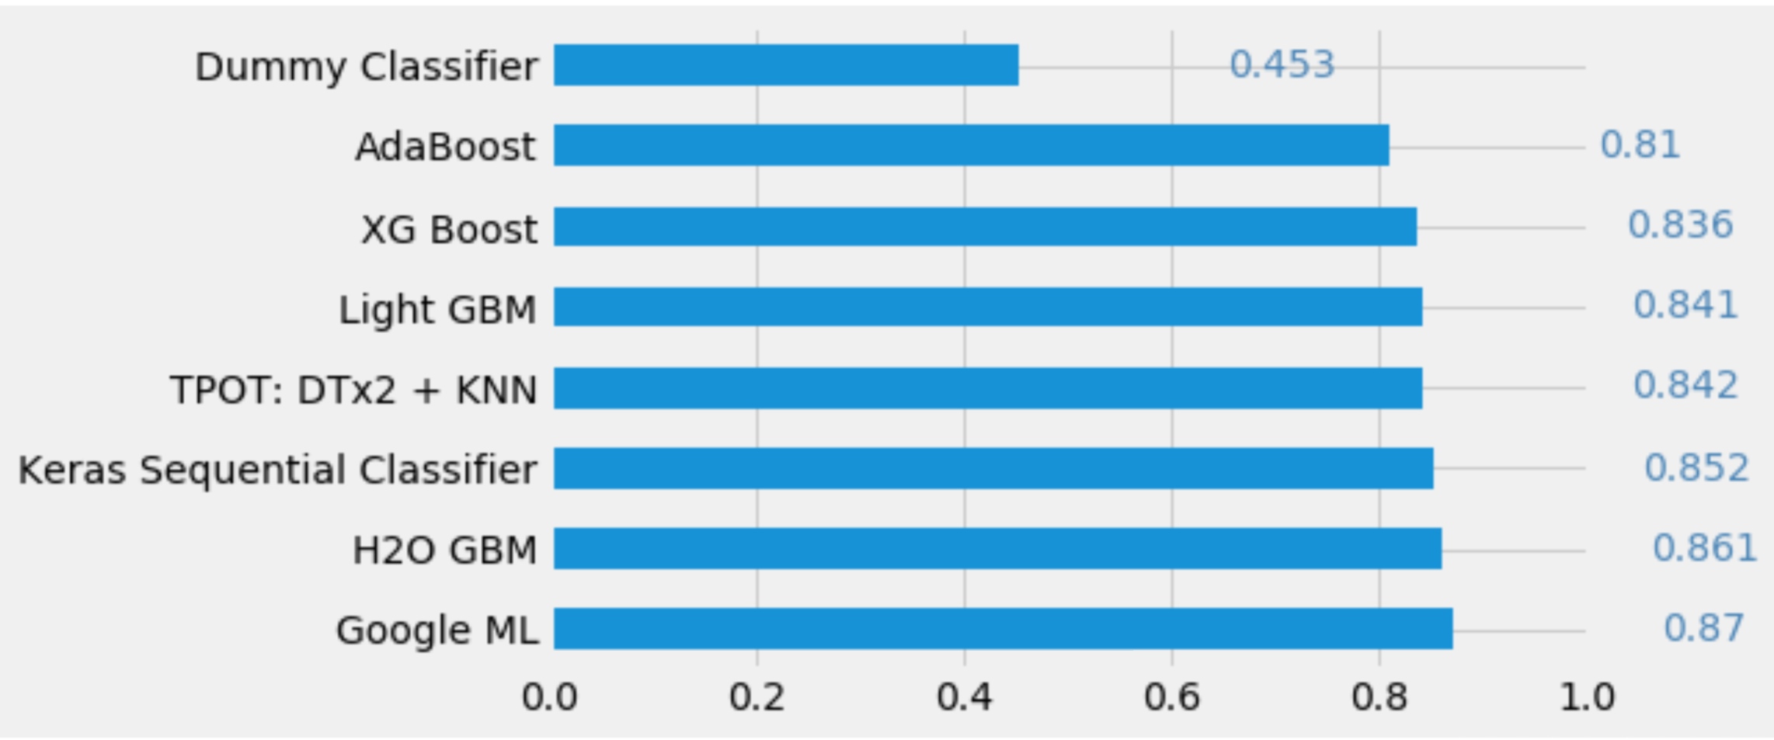
3.a Model Accuracy

Slide 12
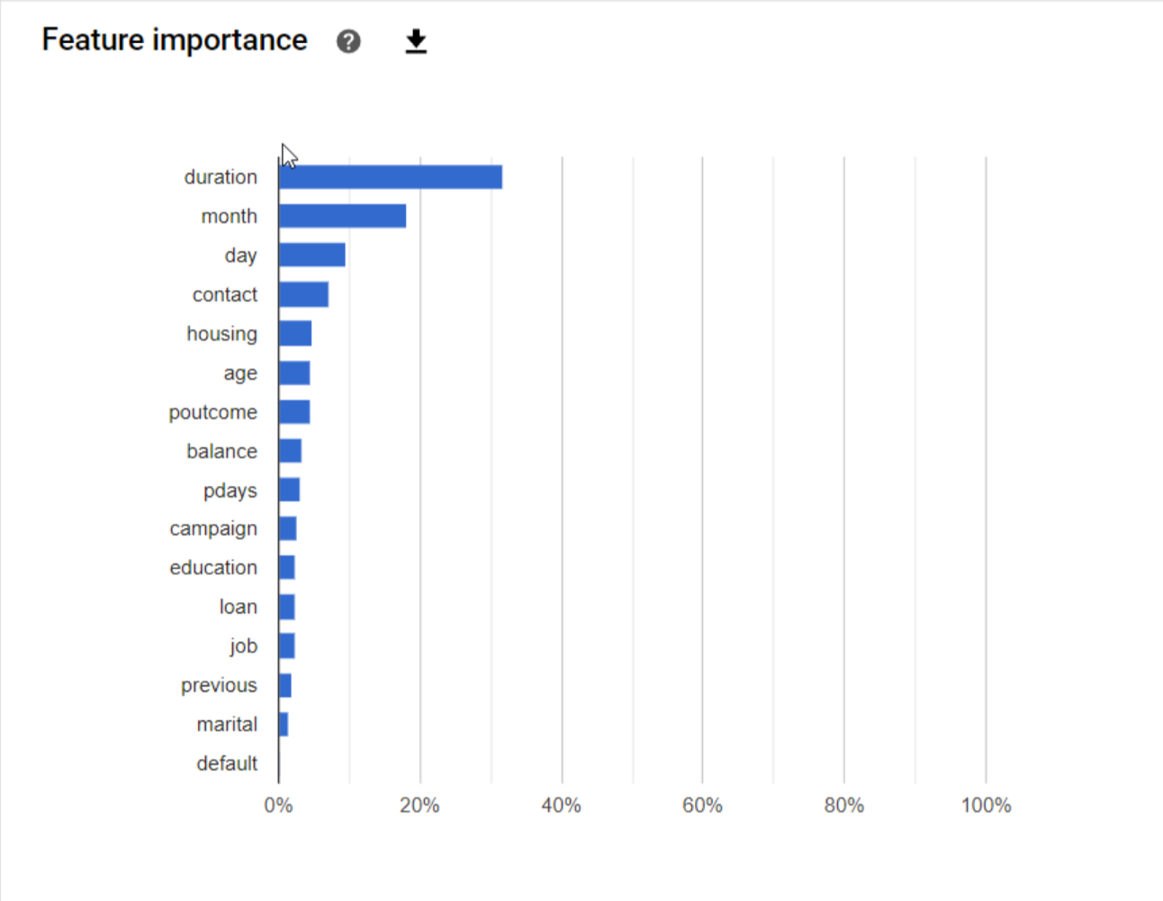
3.b Feature Importance

Slide 13
3.c Confusion Matrix
Predicted
0
1
1398
376
0
79%
21%
Actual
213
1362
1
13%
77%

Slide 14
3.d Chi-squared/ Dowhy
Simulated chi-squared
Do why analysis
Outcome: Deposit
Treatment: Age
Control: Job, Balance, Education, Default, Housing, Loan
Instrument: Marital status, Previous contact, Duration, Day and Month
 | Before campaign | After campaign
Deposit | 4717 | 4212
Did not Deposit | 1156 | 1077
Stratification method:
Causal estimate: -0.029
Regression method:
Causal estimate: -0.027
Results:
Chi-squared value: 0.8034
p-value: 0.669
Insufficient evidence to reject Ho

Slide 15
4. Threats to Validity: The Fairness Bias

Slide 16
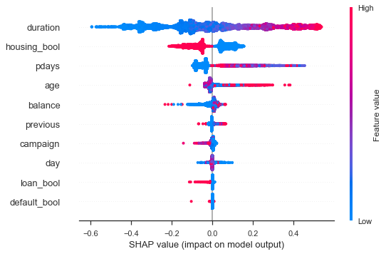
4. Fairness Bias - SHAP
A model is ‘biased’ if it learned from the historical facts of the data
The X-axis represents the SHAP value. This indicates the change in log-odds. Using this number we can extract the probability of success.
This is a positive sign of little bias in our dataset since the common variables associated with bias such as gender and race are not very significant
Notes:
(month with lowest mkt activity

Slide 17
5. Business Recommendations

Slide 18
5. Business Recommendations
Months
Invest more in:
March
September
October
December
Seasonality
Invest more in:
Fall and Winter
Campaign Calls
Implement policy of 3 calls per potential client
More than that, increases chances of being declined open term deposit
Notes:
(month with lowest mkt activity

Slide 19
5. Business Recommendations
Age Category - Cluster
Early 20s
60% Chance of Subscribing
60s and older
76% Chance of Subscribing
House Loans & Balances
Low / No Balance
Higher chances of customers having a house loan
More financial obligations to pay back
High / Average Balance (More than $935)
Lower chances of having a house loan
More likely to open a term deposit
Campaign needs to target individuals of average / high balances

Slide 20
5. Business Recommendations
Focus on Duration of Call
Develop personalized questionnaire and adapt to boost client engagement during call
Above average duration (Above 6 mins)
78% chance of subscribing
Golden sales pitch duration
Aim for around 6 mins
Ignore “Cold-Zone” Age Group
Between 31-53

Slide 21
Questions?

